Slide 1
Dividend-Paying Stocks
報告人：李振綱

Slide 2
Outline
5.5.1 Continuously Paying Dividend
5.5.2 Continuously Paying Dividend with Constant Coefficients
5.5.3 Lump Payments of Dividends
5.5.4 Continuously Paying Dividend with Constant Coefficients

Slide 3




5.5.1 Continuously Paying Dividend
Consider a stock, modeled as a generalized geometric Brownian motion, that pays dividends continuously over time at a rate per unit time. Here is a nonnegative adapted process.
Dividends paid by a stock reduce its value, and so we shall take as our model of the stock price
If is the number of shares held at time t, then the portfolio value
satisfies
Notes:
Complete market
Risk neutral pricing (no arbitrage)

Slide 4
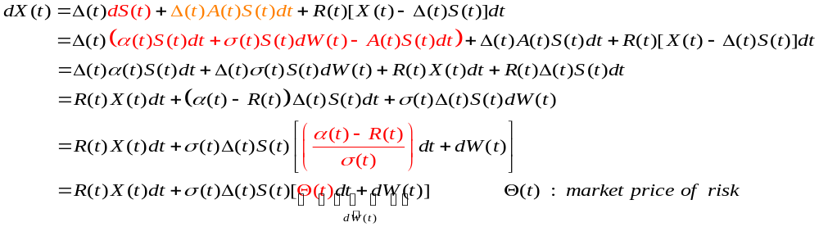








By Girsanov’s Theorem to change to a measure under which is a Brownian motion, so we may rewrite (5.5.2) as
The discounted portfolio value satisfies
If we now wish to hedge a short position in a derivative security paying at time T, where is an random variable, we will need to choose the initial capital and the portfolio process ,
, so that .
Notes:
dD(t)=-R(t)D(t)dt P.215

Slide 5




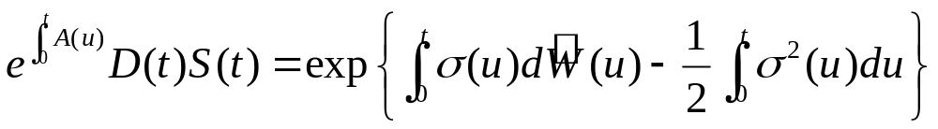
Because is a martingale under , we must have
From (5.5.1) and the definition of , we see that
Under the risk-neutral measure, the stock does not have mean rate of return , and consequently the discounted stock price is not a martingale.
is a martingale. (P.148)

Slide 6
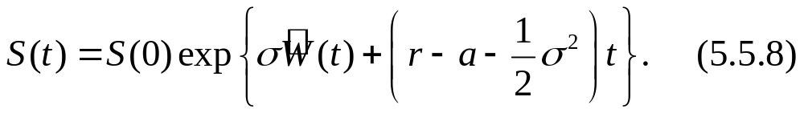

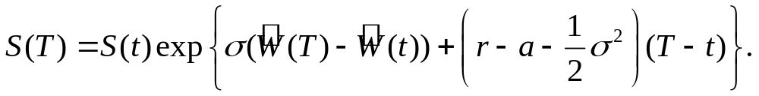
5.5.2 Continuously Paying Dividend with Constant
Coefficients
For , we have
According to the risk-neutral pricing formula, the price at time t of a European call expiring at time T with strike K is

Slide 7
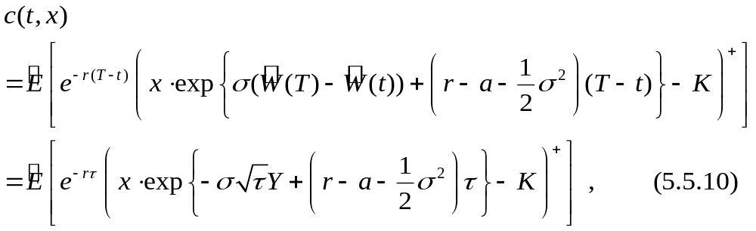
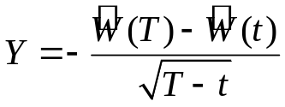


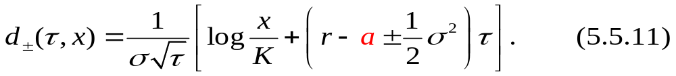
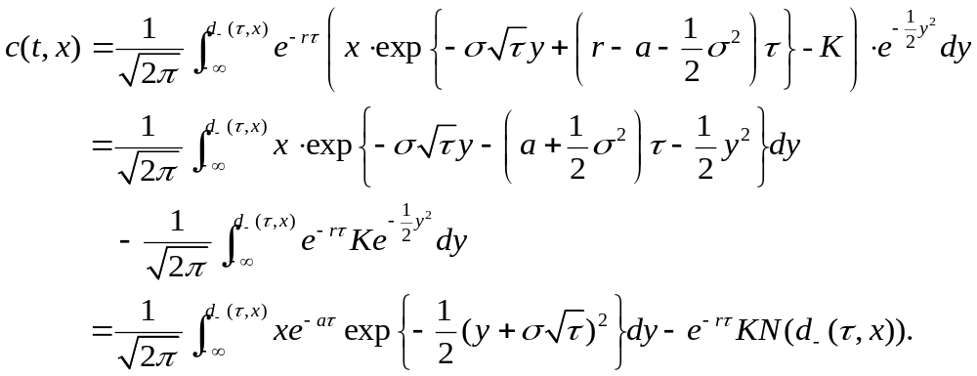
where and is a standard normal r.v. under .
We define

Slide 8

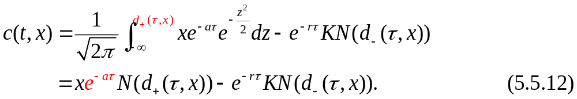
We make the change of variable in the integral, which leads us to the formula

Slide 9










5.5.3 Lump Payments of Dividends
There are times and, at each time , the dividend paid is , where denotes the stock prices just prior to the dividend payment.
We assume that each is an r.v. taking values in [0,1]. However, neither nor is a dividend payment dates(i.e., and ).
We assume that, between dividend payment dates, the stock price follows a generalized geometric Brownian motion:

Slide 10


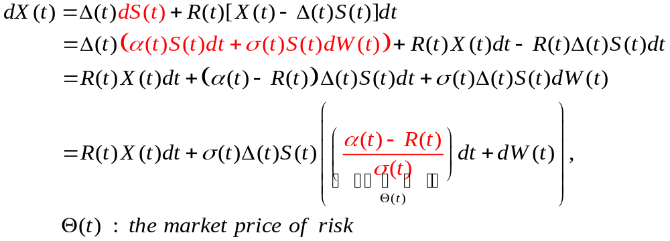

Between dividend payment dates, the differential of the portfolio value corresponding to a portfolio process , , is
At the dividend payment dates, the value of the portfolio stock holdings drops by , but the portfolio collects the dividend , and so the portfolio value does not jump. It follows that

Slide 11

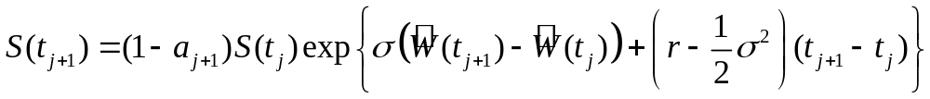
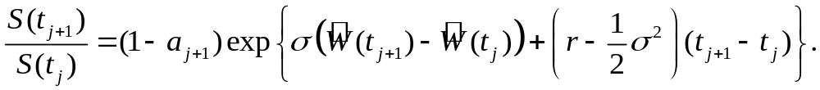

5.5.4 Continuously Paying Dividend with Constant Coefficients
We price a European call under the assumption that , , and each are constant. From(5.5.14) and the definition of , we have
Therefore,
It follows that
左右同乘

Slide 12
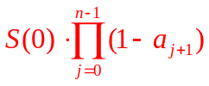
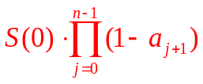
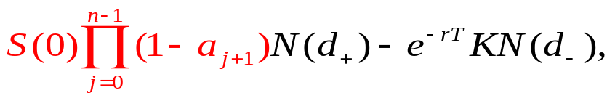
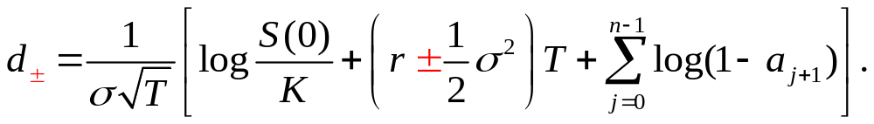
In other words,
This is the same formula we would have for the price at time T of a geometric Brownian motion not paying dividends if the initial stock price were rather than S(0).
Therefore, the price at time zero of a European call on this dividend-paying asset, a call that expires at time T with strike price K, is obtained by replacing the initial stock price by in the classical BSM formula.
where

Slide 13
Thanks for your listening !!

